Slide 1
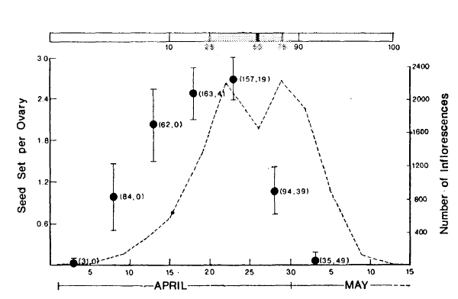
Seed set in Claytonia depends on when you flower.
Schemske 1977

Slide 2
Dunnell and Travers 2011
Am. J. Bot.

Slide 3
Wolkovich et al. 2013, Nature

Slide 4
Sensitivity to temperature decreases throughout the growing season
Wolkovich et al. 2013, Nature

Slide 5
Cook et al. 2012, Ecosyst.

